Slide 1
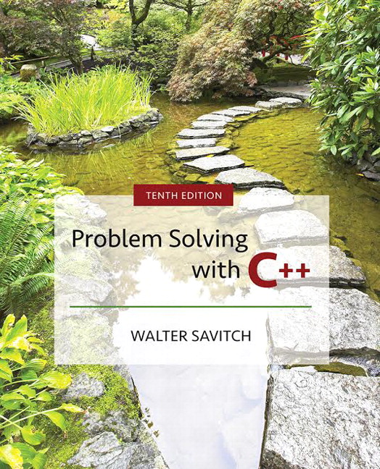

Slide 2
Chapter 13
Pointers and Linked Lists

Slide 3
Overview
13.1 Nodes and Linked Lists
13.2 Stacks and Queues
Slide 13- <number>

Slide 4
13.1
Nodes and Linked Lists

Slide 5
Nodes and Linked Lists
  A linked list is a list that can grow and shrink while the program is running
  A linked list is constructed using pointers
  A linked list often consists of structs or classes that contain a pointer variable connecting them to other dynamic variables
  A linked list can be visualized as items, drawn as boxes, connected to other items by arrows
head
10
12
14 | end
Slide 13- <number>

Slide 6
Nodes
The boxes in the previous drawing represent the
nodes of a linked list
  Nodes contain the data item(s) and a pointer that can point to another node of the same type
    The pointers point to the entire node, not an individual item that might be in the node
The arrows in the drawing represent pointers
Display 13.1
Slide 13- <number>

Slide 7
Implementing Nodes
Nodes are implemented in C++ as structs or
classes
  Example: A structure to store two data items and
  a pointer to another node of the same type,
  along with a type definition might be:
  struct ListNode
  {
  string item;
  int count;
  ListNode *link;
  };
  typedef ListNode* ListNodePtr;
This circular definition
is allowed in C++
Slide 13- <number>

Slide 8
The head of a List
The box labeled head, in display 13.1, is not a
node, but a pointer variable that points to a node
Pointer variable head is declared as:
ListNodePtr head;
Slide 13- <number>

Slide 9
Accessing Items in a Node
Using the diagram of 13.1, this is one way to
change the number in the first node from
10 to 12:
(*head).count = 12;
  head is a pointer variable so *head is the node that head points to
  The parentheses are necessary because the dot operator . has higher precedence than the
  dereference operator *
Slide 13- <number>

Slide 10
The Arrow Operator
The arrow operator -> combines the actions of
the dereferencing operator * and the dot operator
to specify a member of a struct or object pointed
to by a pointer
  (*head).count = 12;
  can be written as
  head->count = 12;
  The arrow operator is more commonly used
Display 13.2
Slide 13- <number>

Slide 11
NULL
The defined constant NULL is used as…
  An end marker for a linked list
    A program can step through a list of nodes by following the pointers, but when it finds a node containing NULL, it knows it has come to the end of the list
  The value of a pointer that has nothing to point to
The value of NULL is 0
Any pointer can be assigned the value NULL:
double* there = NULL;
Slide 13- <number>

Slide 12
To Use NULL
A definition of NULL is found in several
libraries, including <iostream> and <cstddef>
A using directive is not needed for NULL
Slide 13- <number>

Slide 13
nullptr
The fact that the constant NULL is actually the number 0 leads to an ambiguity problem. Consider the overloaded function below:
void func(int *p);
void func(int i);
Which function will be invoked if we call func(NULL)?
To avoid this, C++11 has a new constant, nullptr. It is not the integer zero, but a literal constant used to represent a null pointer.
Slide 13- <number>

Slide 14
Linked Lists
The diagram in Display 13.2 depicts a linked list
A linked list is a list of nodes in which each node
has a member variable that is a pointer that
points to the next node in the list
  The first node is called the head
  The pointer variable head, points to the first node
    The pointer named head is not the head of the list…it points to the head of the list
  The last node contains a pointer set to NULL
Slide 13- <number>

Slide 15
Building a Linked List:
The node definition
Let's begin with a simple node definition:
struct Node
{
int data;
Node *link;
};
typedef Node* NodePtr;
Slide 13- <number>

Slide 16
Building a Linked List:
Declaring Pointer Variable head
With the node defined and a type definition to
make or code easier to understand, we can
declare the pointer variable head:
NodePtr head;
  head is a pointer variable that will point to the
  head node when the node is created
Slide 13- <number>

Slide 17
Building a Linked List:
Creating the First Node
To create the first node, the operator new is used
to create a new dynamic variable:
head = new Node;
  Now head points to the first, and only, node in the list
Slide 13- <number>

Slide 18
Building a Linked List:
Initializing the Node
Now that head points to a node, we need to
give values to the member variables of the node:
head->data = 3;
head->link = NULL;
  Since this node is the last node, the link is set to NULL
Slide 13- <number>

Slide 19
Function headInsert
It would be better to create a function to insert
nodes at the head of a list, such as:
  void headInsert(NodePtr& head, int theNumber);
    The first parameter is a NodePtr parameter that points to the first node in the linked list
    The second parameter is the number to store in the list
  headInsert will create a new node for the number
    The number will be copied to the new node
    The new node will be inserted in the list as the new head node
Slide 13- <number>

Slide 20
Pseudocode for headInsert
Create a new dynamic variable pointed to by
tempPtr
Place the data in the new node called *tempPtr
Make tempPtr's link variable point to the head
node
Make the head pointer point to tempPtr
Display 13.3
Slide 13- <number>

Slide 21
Translating headInsert to C++
The pseudocode for headInsert can be written
in C++ using these lines in place of the lines of
pseudocode:
  NodePtr tempPtr; //create the temporary pointer
  tempPtr = new Node; // create the new node
  tempPtr->data = theNumber; //copy the number
  tempPtr->link = head; //new node points to first node
  head = tempPtr; // head points to new
  // first node
Display 13.4
Slide 13- <number>

Slide 22
An Empty List
A list with nothing in it is called an empty list
An empty linked list has no head node
The head pointer of an empty list is NULL
head = NULL;
  Any functions written to manipulate a linked list
  should check to see if it works on the empty list
Slide 13- <number>

Slide 23
Losing Nodes
You might be tempted to write headInsert using
the head pointer to construct the new node:
head = new Node;
head->data = theNumber;
Now to attach the new node to the list
  The node that head used to point to is now lost!
Display 13.5
Slide 13- <number>

Slide 24
Memory Leaks
Nodes that are lost by assigning their pointers a
new address are not accessible any longer
The program has no way to refer to the nodes
and cannot delete them to return their memory
to the freestore
Programs that lose nodes have a memory leak
  Significant memory leaks can cause system crashes
Slide 13- <number>

Slide 25
Searching a Linked List
To design a function that will locate a particular
node in a linked list:
  We want the function to return a pointer to the node so we can use the data if we find it, else return NULL
  The linked list is one argument to the function
  The data we wish to find is the other argument
  This declaration will work:
  NodePtr search(NodePtr head, int target);
Slide 13- <number>

Slide 26
Function search
Refining our function
  We will use a local pointer variable, named here, to move through the list checking for the target
    The only way to move around a linked list is to follow pointers
  We will start with here pointing to the first node and move the pointer from node to node following the pointer out of each node
Display 13.6
Slide 13- <number>

Slide 27
Pseudocode for search
Make pointer variable here point to the head node
while(here does not point to a node containing target
AND here does not point to the last node)
{
make here point to the next node
}
If (here points to a node containing the target)
return here;
else
return NULL;
Slide 13- <number>

Slide 28
Moving Through the List
The pseudocode for search requires that pointer
here step through the list
  How does here follow the pointers from node to node?
  When here points to a node, here->link is the
  address of the next node
  To make here point to the next node, make the
  assignment:
  here = here->link;
Slide 13- <number>

Slide 29
A Refinement of search
The search function can be refined in this way:
  here = head;
  while(here->data != target && here->link != NULL)
  {
  here = here->next;
  }
  if (here->data = = target)
  return here;
  else
  return NULL;
Check for last node
Slide 13- <number>

Slide 30
Searching an Empty List
Our search algorithm has a problem
  If the list is empty, here equals NULL before the while loop so…
    here->data is undefined
    here->link is undefined
  The empty list requires a special case in our
  search function
  A refined search function that handles an empty list is shown in
Display 13.7
Slide 13- <number>

Slide 31
Pointers as Iterators
An iterator is a construct that allows you to
cycle through the data items in a data structure
to perform an action on each item
  An iterator can be an object of an iterator class,
  an array index, or simply a pointer
A general outline using a pointer as an iterator:
Node_Type *iter;
for (iter = Head; iter != NULL; iter = iter->Link)
//perform the action on the node iter points to
  Head is a pointer to the head node of the list
Slide 13- <number>

Slide 32
Iterator Example
Using the previous outline of an iterator we
can display the contents of a linked list in this
way:
NodePtr iter;
for (iter = Head; iter != NULL; iter = iter->Link)
cout << (iter->data);
Slide 13- <number>

Slide 33
Inserting a Node Inside a List
To insert a node after a specified node in the
linked list:
  Use another function to obtain a pointer to the node after which the new node will be inserted
    Call the pointer afterMe
  Use function insert, declared here to insert the node:
  void insert(NodePtr afterMe, int theNumber);
Display 13.8
Slide 13- <number>

Slide 34
Inserting the New Node
Function insert creates the new node just as
headInsert did
We do not want our new node at the head of the
list however, so…
  We use the pointer afterMe to insert the new node
Slide 13- <number>

Slide 35
Inserting the New Node
This code will accomplish the insertion of the
new node, pointed to by tempPtr, after the node
pointed to by afterMe:
tempPtr->link = afterMe->link;
afterMe->link = tempPtr;
2
3
7
9
head
2
2
2
0
5
afterMe
tempPtr
2
Slide 13- <number>

Slide 36
Caution!
The order of pointer assignments is critical
  If we changed afterMe->link to point to
  tempPtr first, we would loose the rest of the list!
The complete insert function is shown
in
Display 13.9
Slide 13- <number>

Slide 37
Function insert Again
Notice that inserting into a linked list requires
that you only change two pointers
  This is true regardless of the length of the list
  Using an array for the list would involve copying as many as all of the array elements to new locations to make room for the new item
Inserting into a linked list is often more efficient
than inserting into an array
Slide 13- <number>

Slide 38
Removing a Node
To remove a node from a linked list
  Position a pointer, before, to point at the node prior to the node to remove
  Position a pointer, discard, to point at the node
  to remove
  Perform: before->link = discard->link;
    The node is removed from the list, but is still in memory
  Return *discard to the freestore: delete discard;
Display 13.10
Slide 13- <number>

Slide 39
Assignment With Pointers
If head1 and head2 are pointer variables and
head1 points to the head node of a list:
head2 = head1;
causes head2 and head1 to point to the same list
  There is only one list!
If you want head2 to point to a separate copy,
you must copy the list node by node or
overload the assignment operator appropriately
Slide 13- <number>

Slide 40
Variations on Linked Lists
Many other data structures can be constructed using nodes and pointers
Doubly-Linked List
  Each node has two links, one to the next node and one to the previous node
  Allows easy traversal of the list in both directions
  struct Node
  {
  int data;
  Node *forwardLink;
  Node *backLink;
  };
Display 13.11
Slide 13- <number>

Slide 41
Binary Tree
A tree is a data structure that looks like an upside-down tree with the root at the top
  No cycles
In a binary tree each node has at most two links
  struct TreeNode
  {
  int data;
  TreeNode *leftLink;
  TreeNode *rightLink;
  };
Display 13.12
Slide 13- <number>

Slide 42
Linked List of Classes
The preceding examples created linked lists of structs. We can also create linked lists using classes.
Logic to use a class is identical except the syntax of using and defining a class should be substituted in place of that for a struct
Interface and Definition for a Node Class
Display 13.13
Display 13.14 (1-2)
Slide 13- <number>

Slide 43
Program using the Node class
We can create a linked list of numbers using the Node class.
Display 13.15 (1-3)
Slide 13- <number>

Slide 44
Section 13.1 Conclusion
Can you
  Write type definitions for the nodes and pointers in a linked list? Call the node type NodeType and call the pointer type PointerType. The linked lists will be lists of letters.
  Explain why inserting into an array can be less
  efficient than inserting into a linked list?
Slide 13- <number>

Slide 45
13.2
Stacks and Queues

Slide 46
A Linked List Application
A stack is a data structure that retrieves data in
the reverse order the data was stored
  If 'A', 'B', and then 'C' are placed in a stack, they will be removed in the order 'C', 'B', and then 'A'
A stack is a last-in/first-out data structure like
the stack of plates in a cafeteria; adding a plate
pushes down the stack and the top plate is the
first one removed
Display 13.16
Slide 13- <number>

Slide 47
Program Example:
A Stack Class
We will create a stack class to store characters
  Adding an item to a stack is pushing onto the stack
  Member function push will perform this task
  Removing an item from the stack is popping the the item off the stack
  Member function pop will perform this task
contains the stack class interface
Display 13.17
Slide 13- <number>

Slide 48
Using the stack Class
demonstrates the use of the
stack class
Display 13.18 (1-2)
Slide 13- <number>

Slide 49
Function push
The push function adds an item to the stack
  It uses a parameter of the type stored in the stack
  void push(char the_symbol);
  Pushing an item onto the stack is precisely the same task accomplished by function headInsert of the linked list
  For a stack, a pointer named top is used instead of a pointer named head
Slide 13- <number>

Slide 50
Function pop
The pop function returns the item that was at
the top of the stack
char pop( );
  Before popping an item from a stack, pop checks
  that the stack is not empty
  pop stores the top item in a local variable result,
  and the item is "popped" by: top = top->link;
    A temporary pointer must point to the old top item
    so it can be "deleted" to prevent a memory leak
  pop then returns variable result
Slide 13- <number>

Slide 51
Empty Stack
An empty stack is identified by setting the
top pointer to NULL
top = NULL;
Slide 13- <number>

Slide 52
The Copy Constructor
Because the stack class uses a pointer and
creates new nodes using new, a copy constructor
is needed
  The copy constructor (a self-test exercise) must make a copy of each item in the stack and store the copies in a new stack
    Items in the new stack must be in the same position in the stack as in the original
Slide 13- <number>

Slide 53
The stack destructor
Because function pop calls delete each time an
item is popped off the stack, ~stack only needs
to call pop until the stack is empty
char next;
while( ! empty ( ) )
{
next = pop( );
}
Slide 13- <number>

Slide 54
stack Class Implementation
The stack class implementation is
found in
Display 13.19 (1)
Display 13.19 (2)
Slide 13- <number>

Slide 55
A Queue
A queue is a data structure that retrieves data in
the same order the data was stored
  If 'A', 'B', and then 'C' are placed in a queue, they will be removed in the order ‘A', 'B', and then ‘C'
A queue is a first-in/first-out data structure like
the checkout line in a supermarket
Display 13.20
Slide 13- <number>

Slide 56
Queue Class Implementation
The queue class is implemented in a manner similar to the stack except there are two pointers, one to track the front of the list, and one to track the back of the list
Interface:
Program using the Queue Class:
Implementation:
Display 13.21 (1-2)
Display 13.22 (1-2)
Display 13.23 (1-3)
Slide 13- <number>

Slide 57
Section 13.2 Conclusion
Can you
  Give the definition of member function push?
  Create a definition for the stack class copy
  constructor?
  Know when to use a queue vs. a stack?
  Create a definition for the queue class copy constructor?
Slide 13- <number>

Slide 58
Chapter 13 -- End
Slide 13- <number>

Slide 59
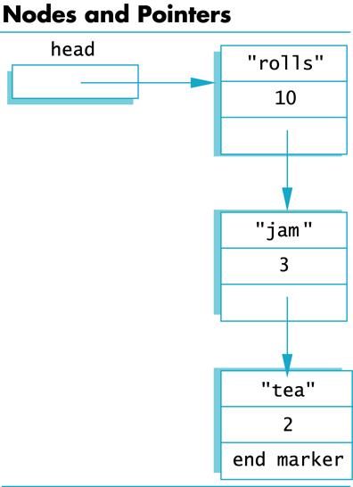
Display 13.1
Back
Next
Slide 13- <number>

Slide 60
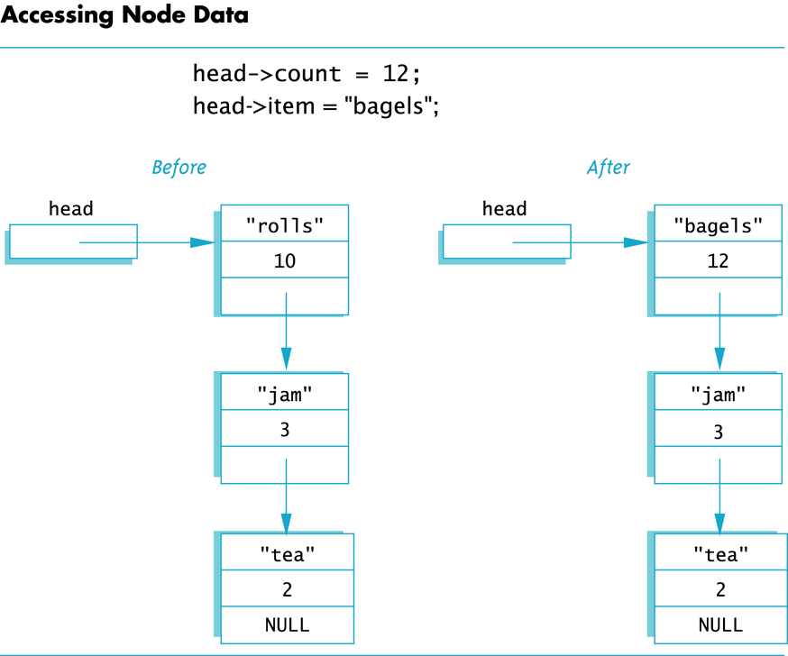
Display 13.2
Back
Next
Slide 13- <number>

Slide 61
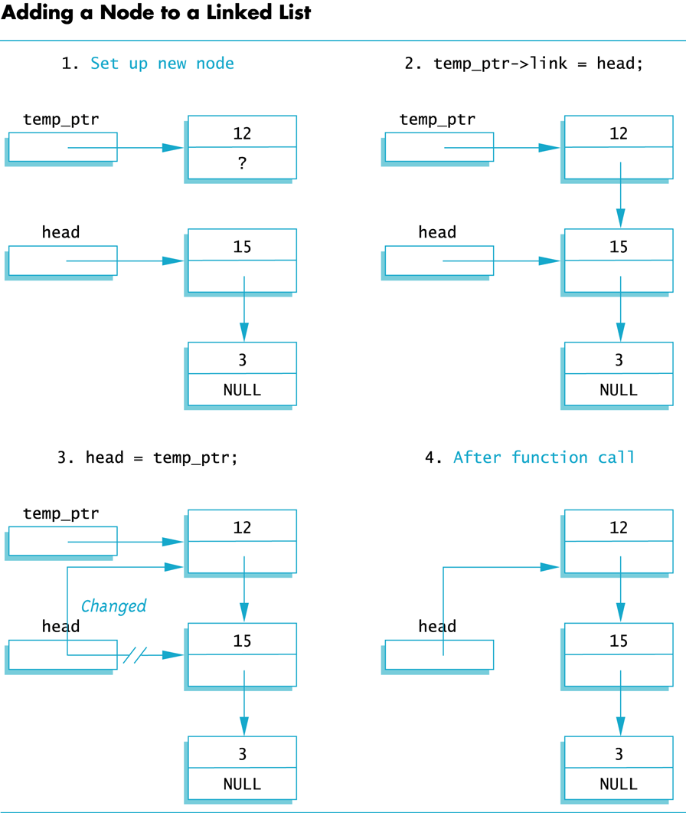
Display 13.3
Back
Next
Slide 13- <number>

Slide 62
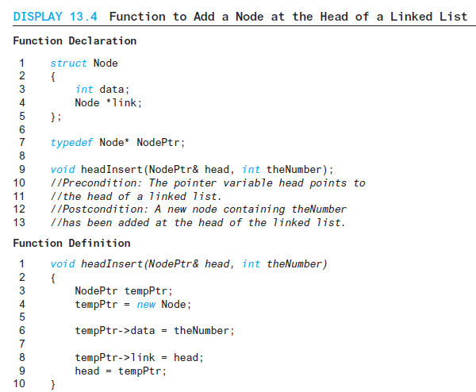
Display 13.4
Back
Next
Slide 13- <number>

Slide 63
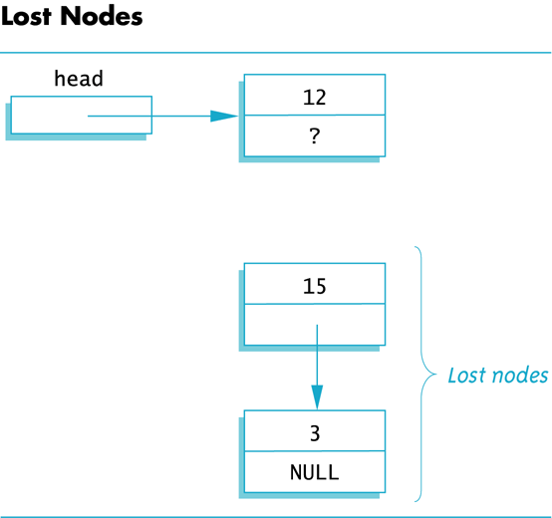
Display 13.5
Back
Next
Slide 13- <number>

Slide 64
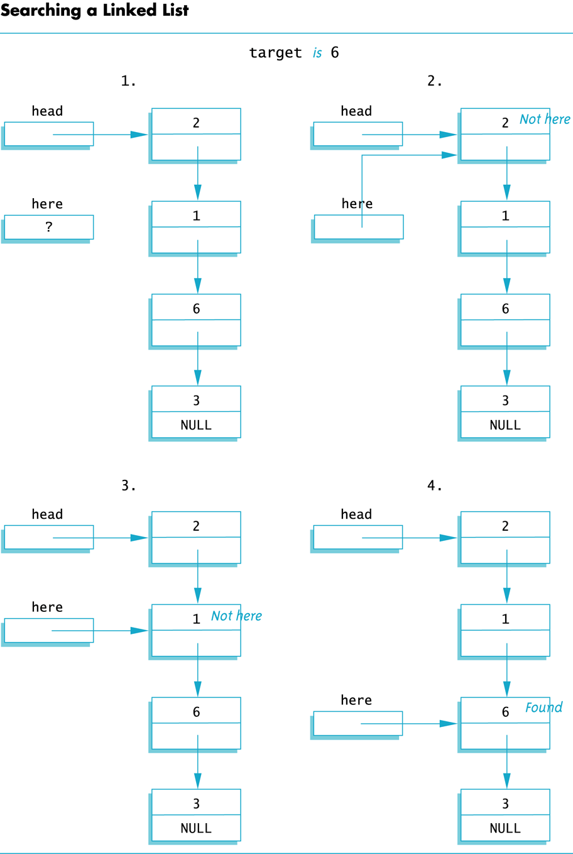
Display 13.6
Back
Next
Slide 13- <number>

Slide 65
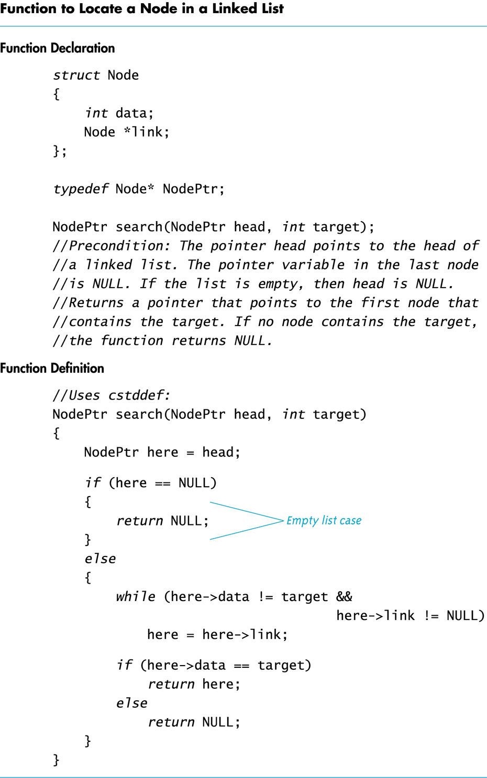
Display 13.7
Back
Next
Slide 13- <number>

Slide 66
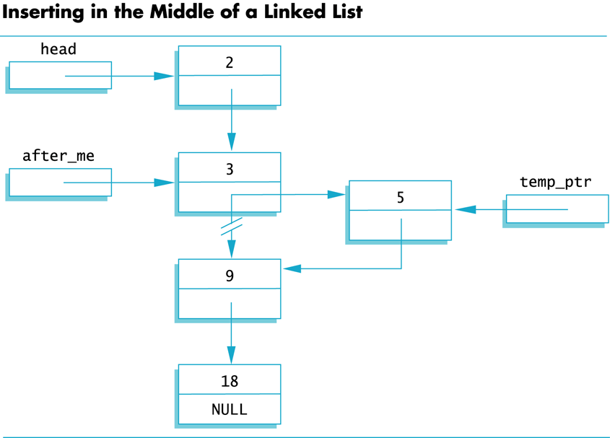
Display 13.8
Back
Next
Slide 13- <number>

Slide 67
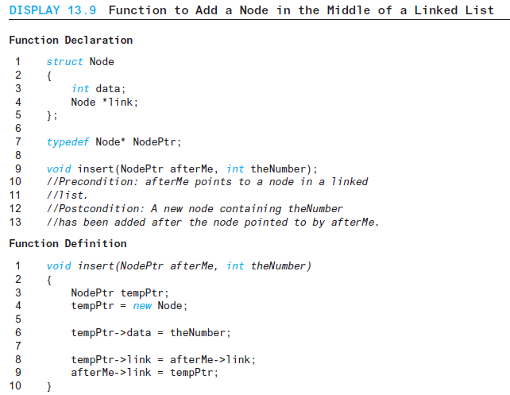
Display 13.9
Back
Next
Slide 13- <number>

Slide 68
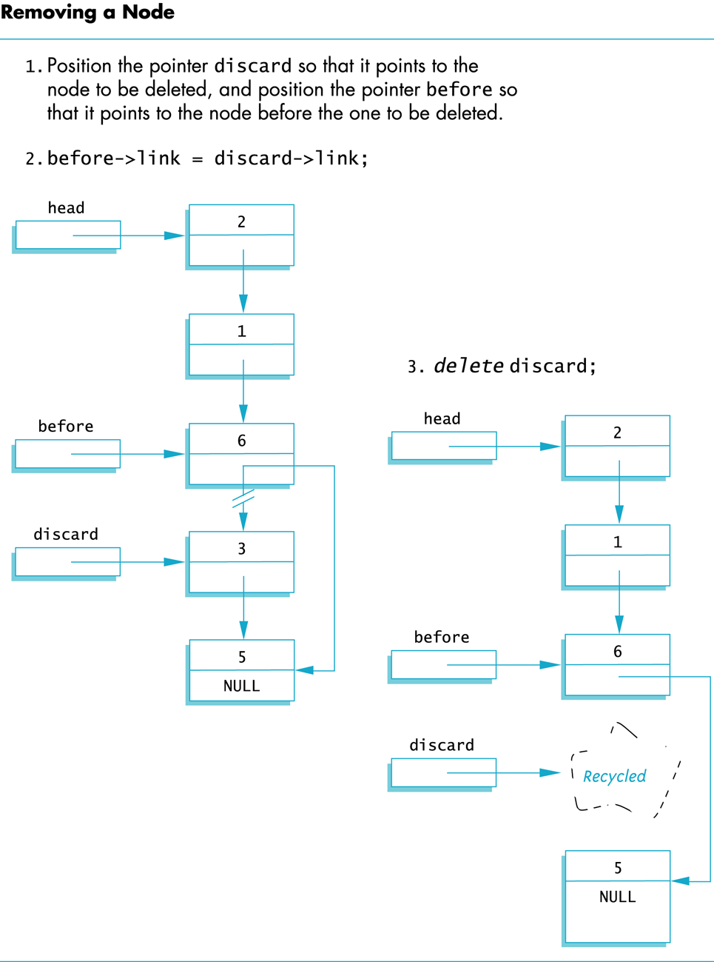
Display 13.10
Back
Next
Slide 13- <number>

Slide 69
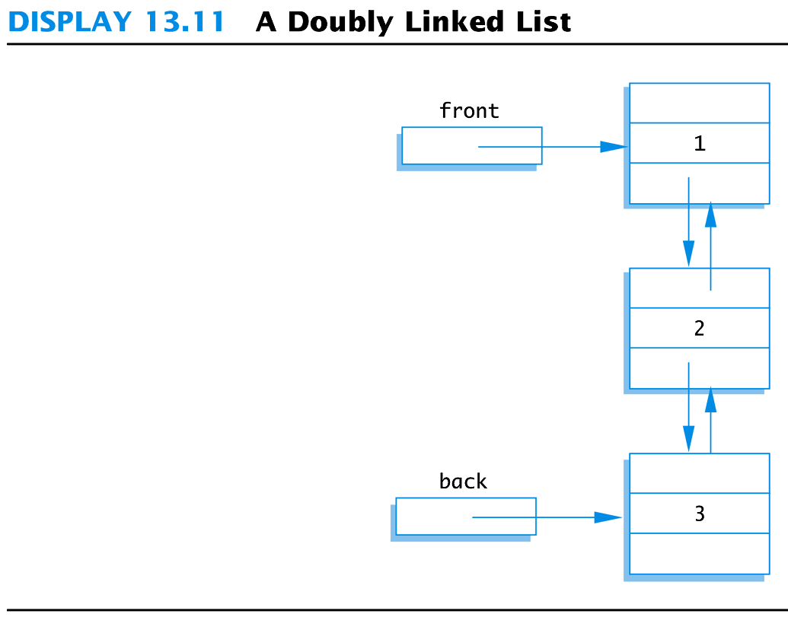
Display 13.11
Back
Next
Slide 13- <number>

Slide 70
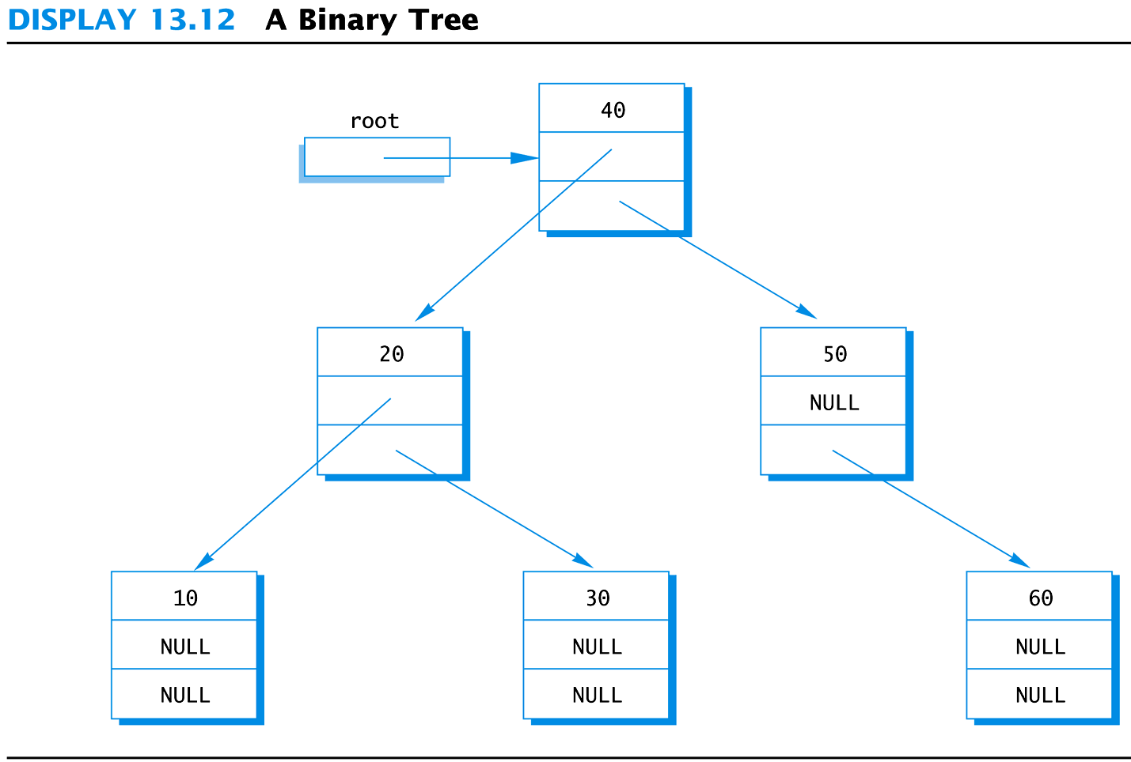
Display 13.12
Back
Next
Slide 13- <number>

Slide 71
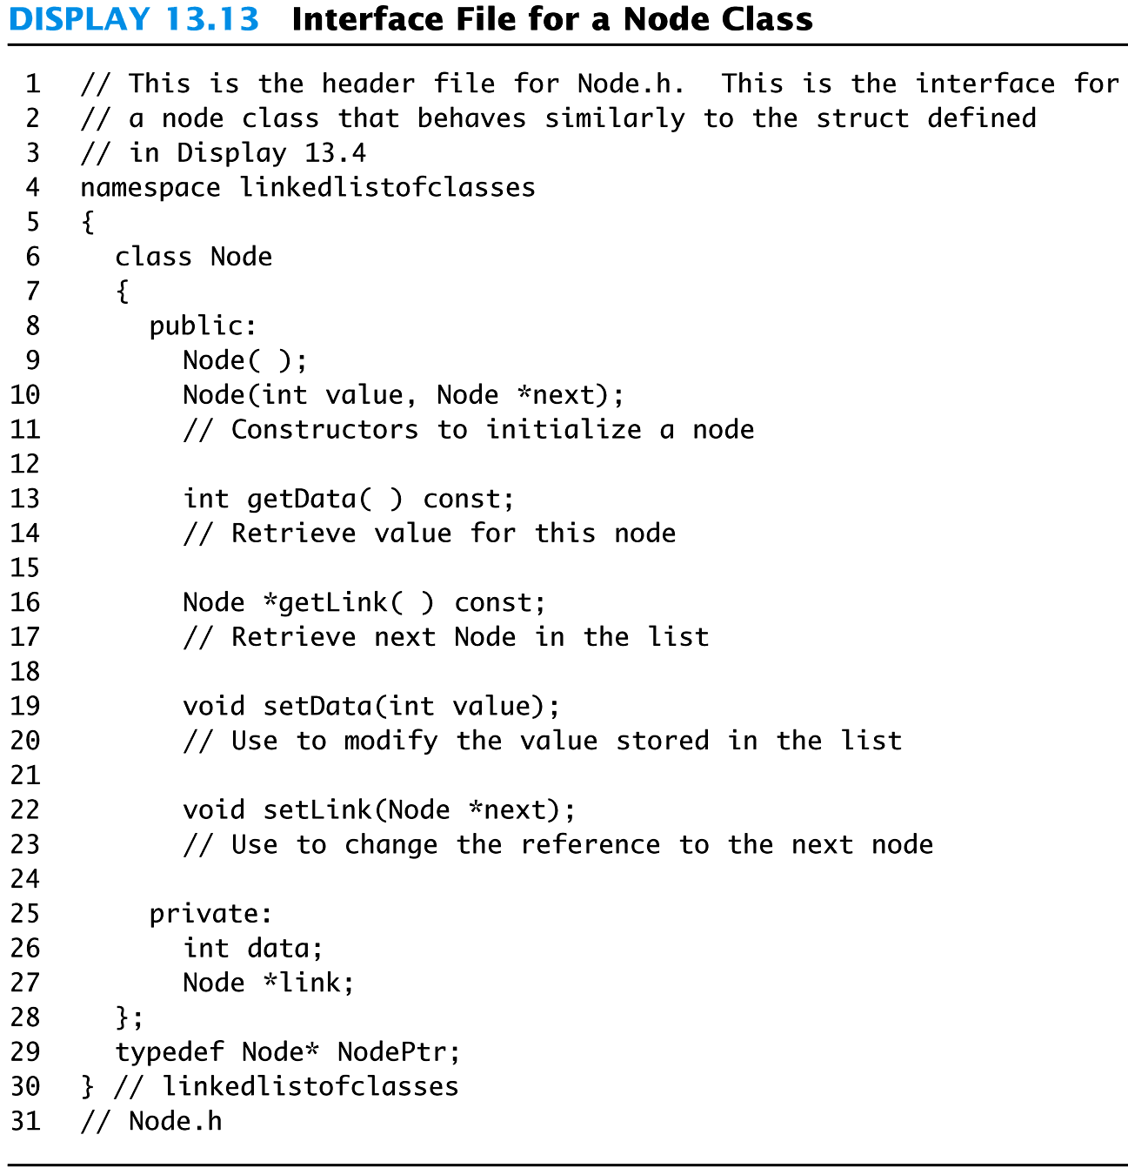
Display 13.13
Back
Next
Slide 13- <number>

Slide 72
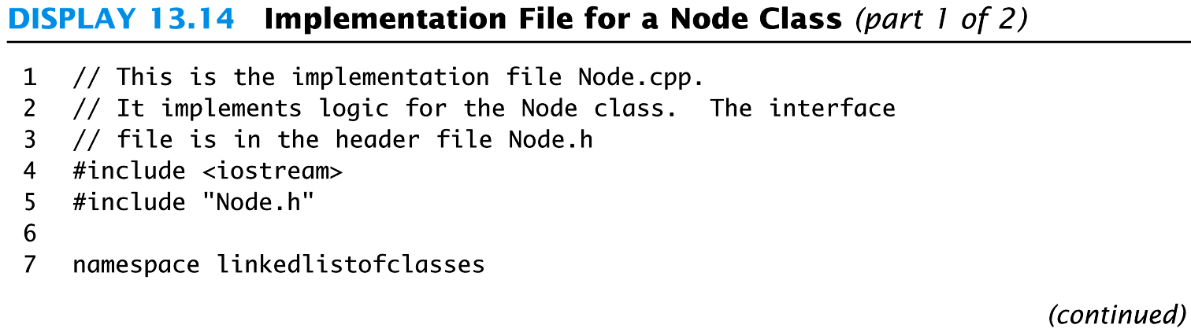
Display 13.14 (1/2)
Back
Next
Slide 13- <number>

Slide 73
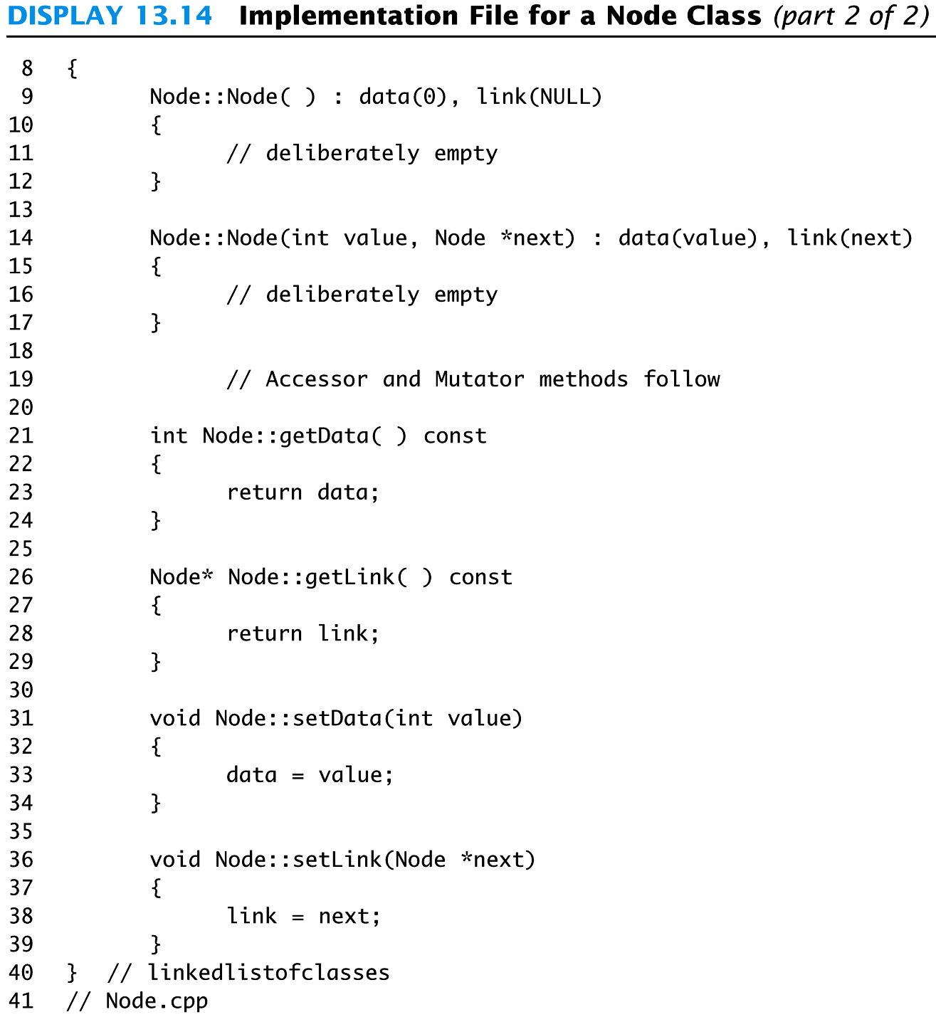
Display 13.14 (2/2)
Back
Next
Slide 13- <number>

Slide 74

Display 13.15 (1/3)
Back
Next
Slide 13- <number>

Slide 75
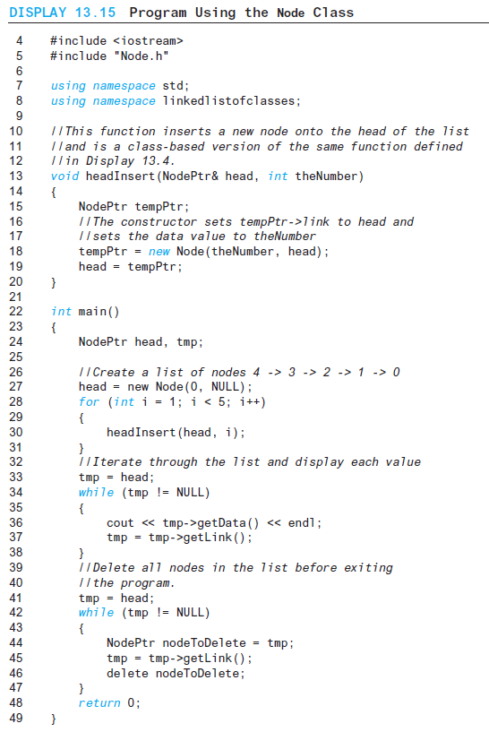
Display 13.15 (2/3)
Back
Next
Slide 13- <number>

Slide 76
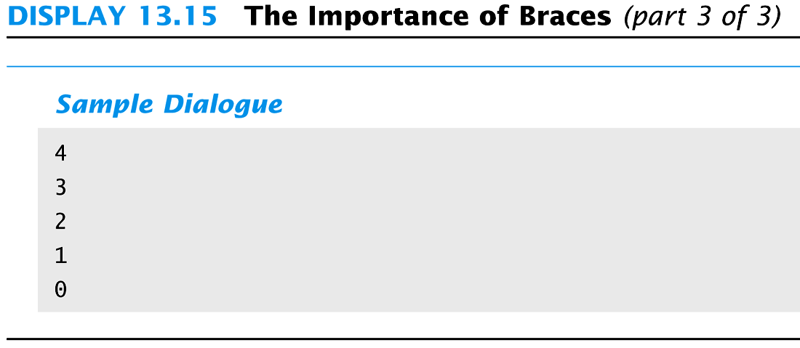
Display 13.15 (3/3)
Back
Next
Slide 13- <number>

Slide 77
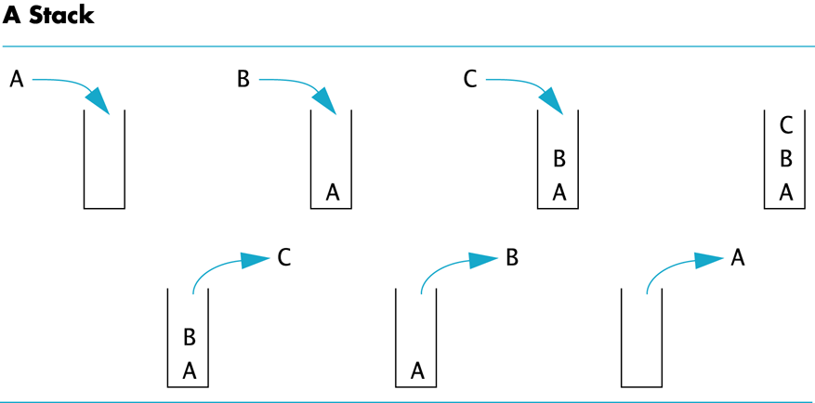
Display 13.16
Back
Next
Slide 13- <number>

Slide 78
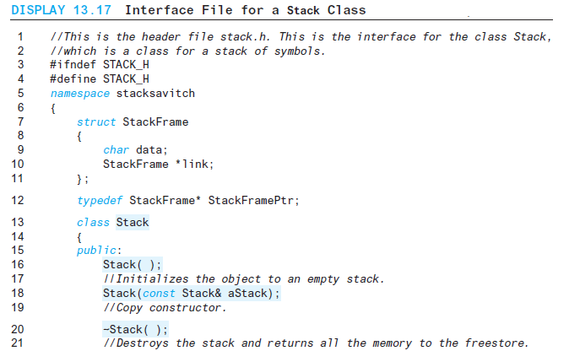
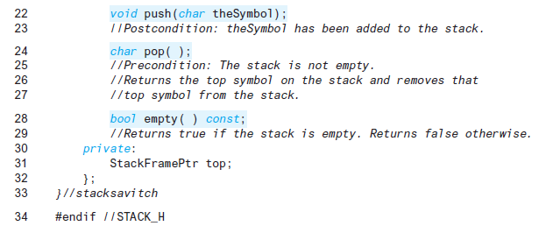
Display 13.17
Back
Next
Slide 13- <number>

Slide 79
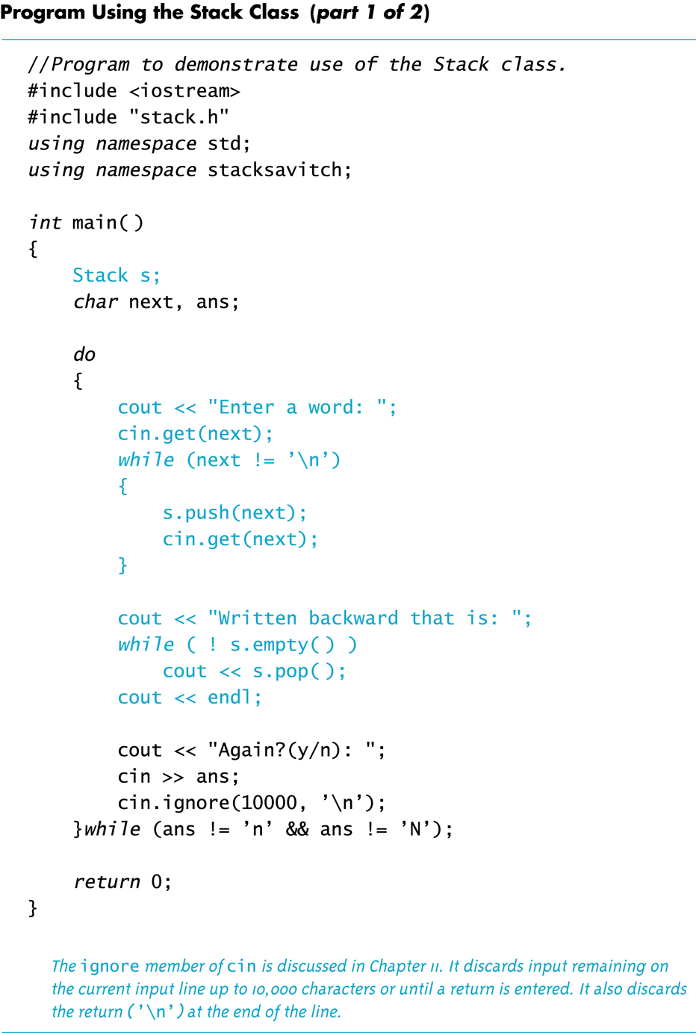
Display 13.18 (1/2)
Back
Next
Slide 13- <number>

Slide 80
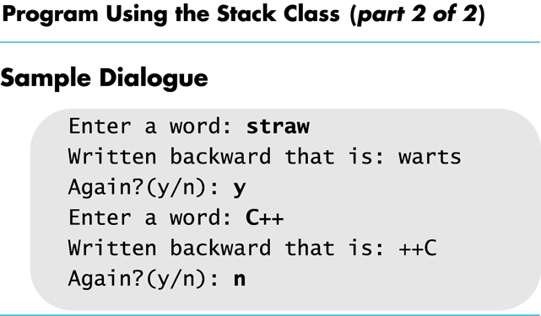
Display 13.18
(2/2)
Back
Next
Slide 13- <number>

Slide 81
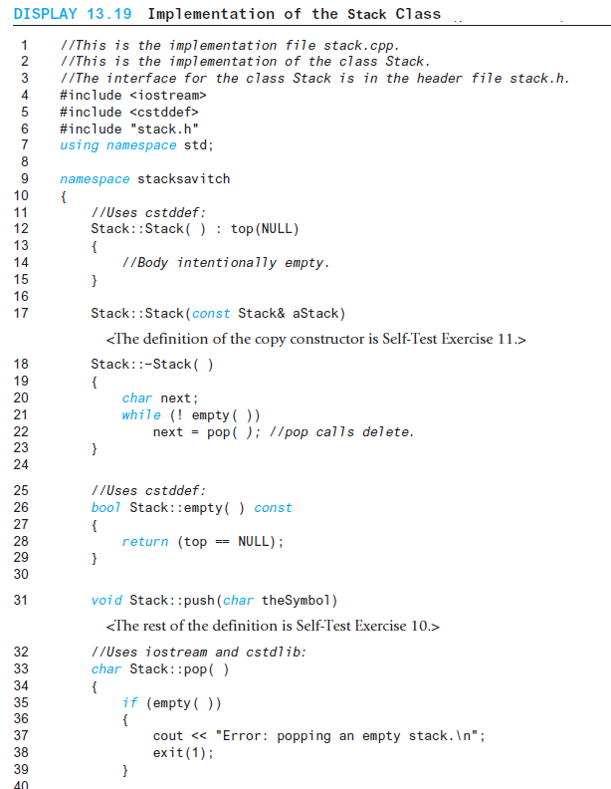
Display 13.19 (1/2)
Back
Next
Slide 13- <number>

Slide 82
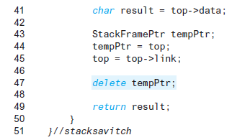
Display 13.19 (2/2)
Back
Next
Slide 13- <number>

Slide 83
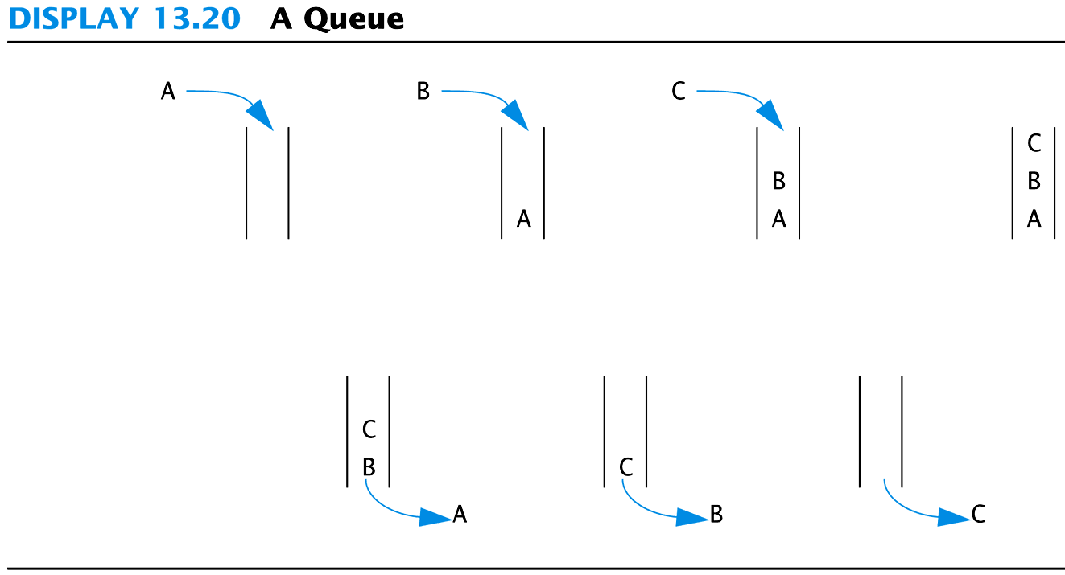
Display 13.20
Back
Next
Slide 13- <number>

Slide 84
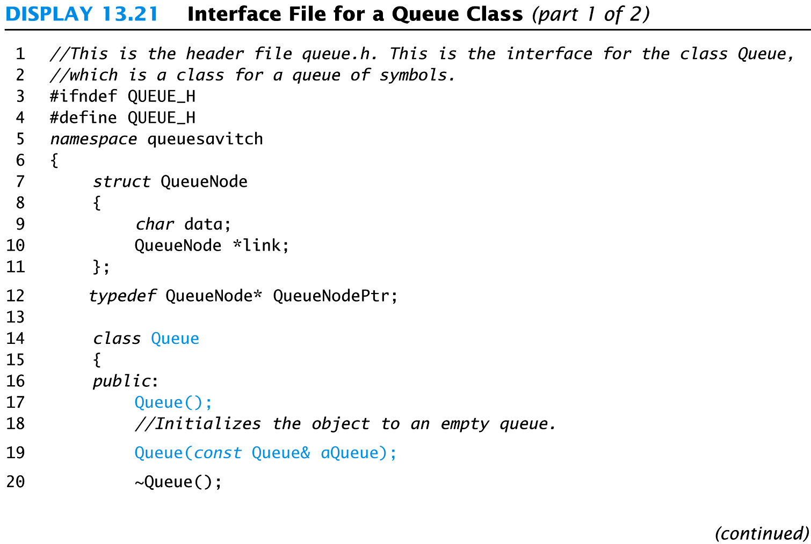
Display 13.21 (1/2)
Back
Next
Slide 13- <number>

Slide 85
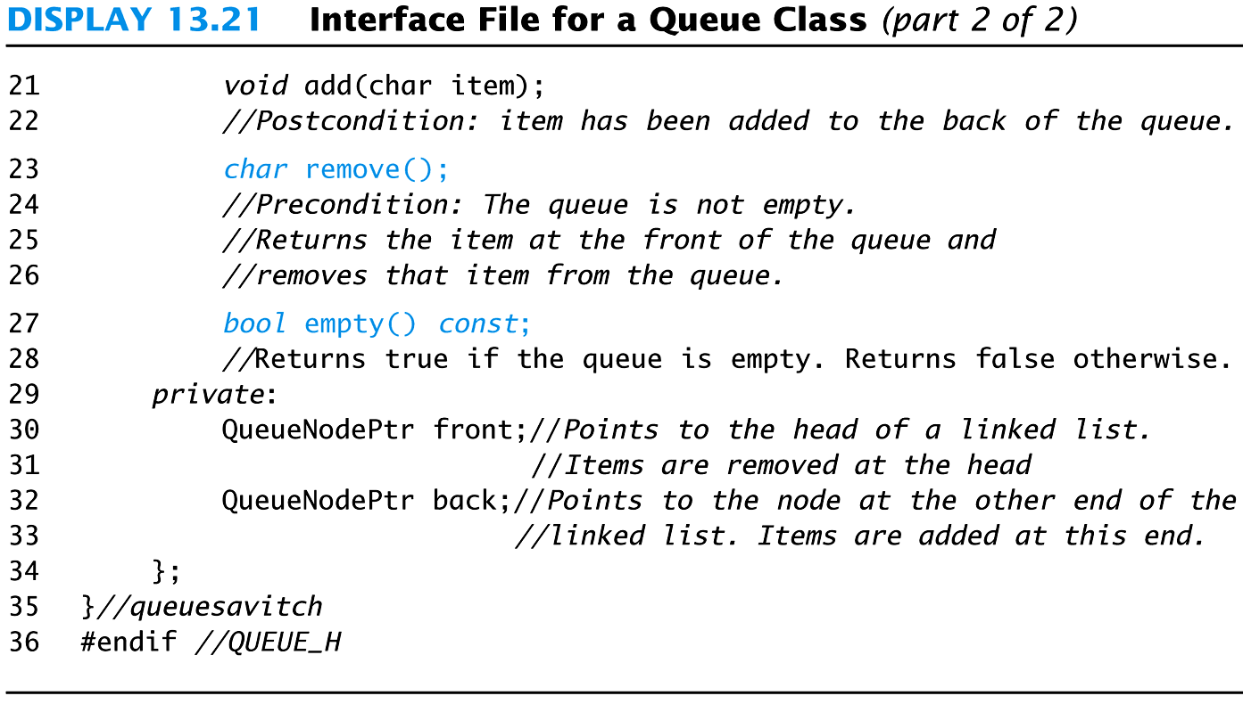
Display 13.21 (2/2)
Back
Next
Slide 13- <number>

Slide 86
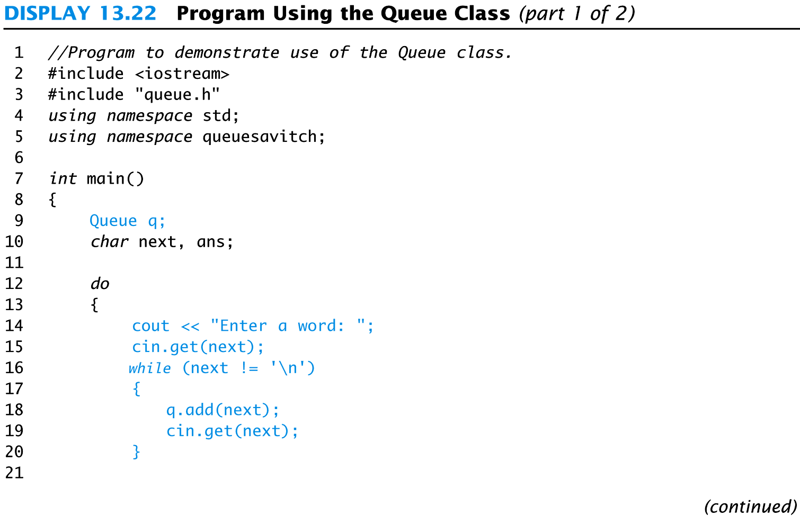
Display 13.22 (1/2)
Back
Next
Slide 13- <number>

Slide 87
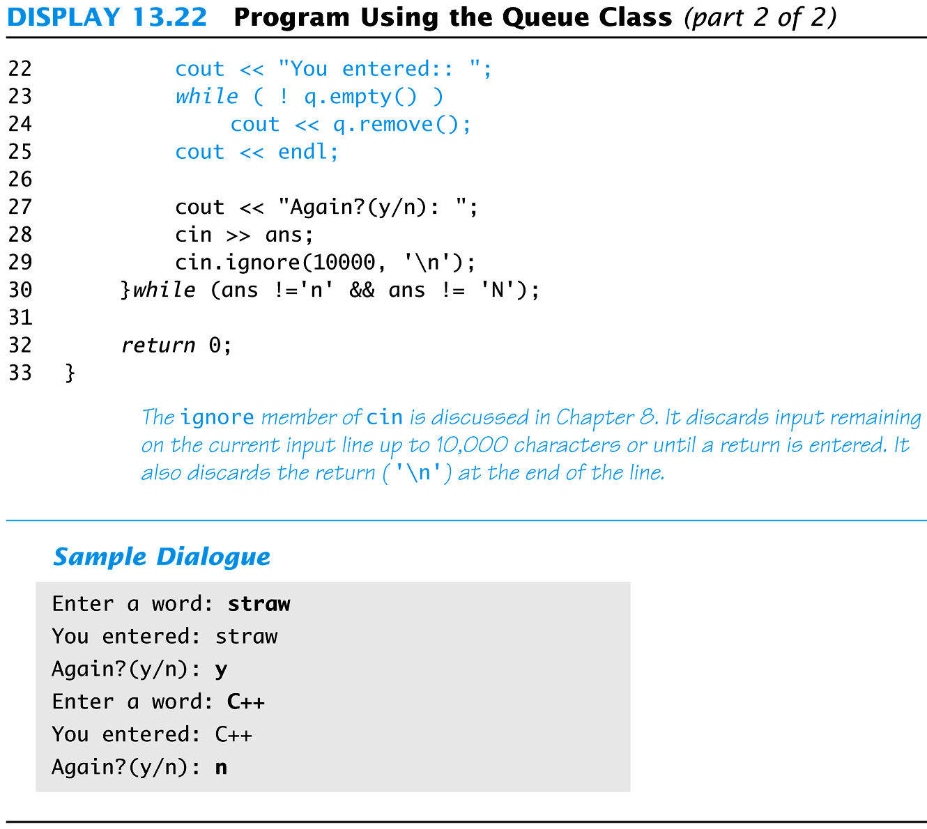
Display 13.22 (2/2)
Back
Next
Slide 13- <number>

Slide 88
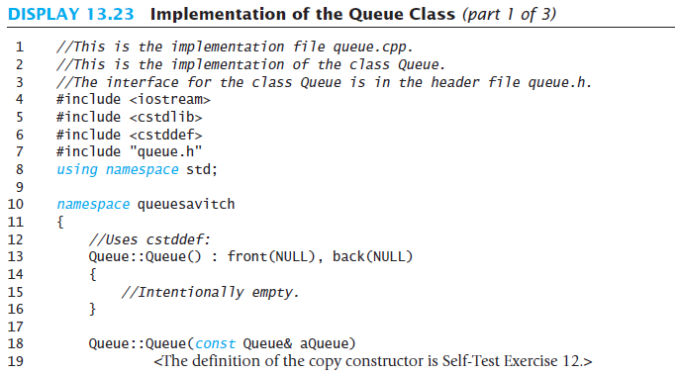
Display 13.23 (1/3)
Back
Next
Slide 13- <number>

Slide 89
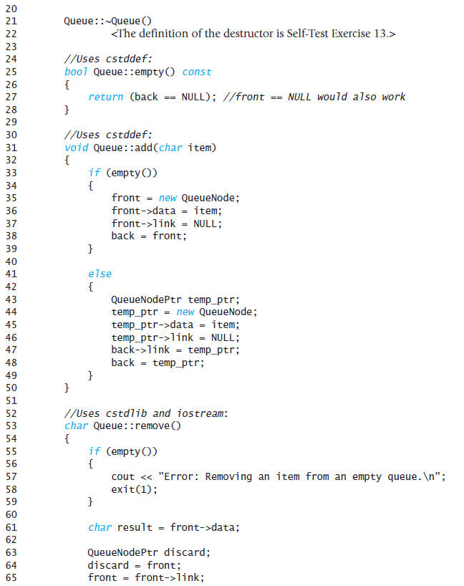
Display 13.23 (2/3)
Back
Next
Slide 13- <number>

Slide 90
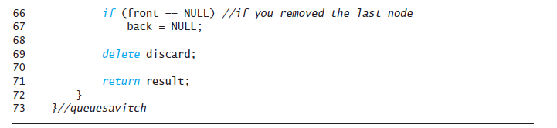
Display 13.23 (3/3)
Back
Next
Slide 13- <number>

